Slide 1
Online Inventory Management System
Name: Amil Dev S
Notes:
ID=d924773e-9a16-4d6d-9803-8cb819e99682 Recipe=text_billboard Type=TextOnly Variant=0 FamilyID=AccentBoxWalbaum_Zero

Slide 2

Agenda
1. Abstract :………………...........................................03
2. Project Requirements :………………………..........04
3. Features and highlights:……………………………05
4. Technical aspects : …………………………………06
5. Challenges faced during the development :………..09
6. Important Screenshots with explanation :………….10
7. Future enhancements :……………………………...15
8. Conclusion :……………………………...................16
9. References:…………………………………………17

Slide 3

Abstract
The Online Inventory Management System is a Django-based web application designed to streamline and automate inventory management processes. The primary goal of the Online Inventory Management system is to provide businesses with a centralized solution to manage their inventory efficiently.
The system provides an efficient and user-friendly platform for managing inventory, tracking stock levels and issue stock to the customer.

Slide 4

Project Requirements
Provide authentication to secure the system.
Ability to manage products in the inventory.
Ability to manage staff details.
Check stock availability.
Low stock alerts.
Generation of reports.

Slide 5

Features And Highlights
Login functionality to secure the system.
Add, edit, and delete products in the inventory.
Real-time tracking of inventory levels and stock availability.
Alerts for low stock or out-of-stock items.
Export available stocks to csv file.
Can update profile details of the staffs and admin.
Invoice generation for each issued product.
Generate visualized reports to analyze inventory levels.
SMS alerts to notify customers when stock is issued.
Mini chatbot to guide the newly joined staff.

Slide 6





Technical Aspects
Django Libraries & Third Party APIs
Admin Page: - django-jazzmin
CSS:- Bootstrap5
Forms:- django-crispy-forms
Login:- django-registration-redux
ChatBot:- Dialogflow
SMS Alert:- Twilio
PDF Generation:- reportlab
Import & Export of Stock:- django-import-export
Visualization:- Chartjs
26/05/2023

Slide 7
Architecture Of The Project
Presentation Layer:
User Interface (UI) using HTML, CSS, JavaScript
Templates for rendering dynamic content
Views to handle user requests and responses
Application Layer:
Django Framework as the web application framework
Business logic implementation
Models representing inventory items, orders, users, etc.
Forms for data validation and user input handling
Database:
Relational Database Management System (MySQL)
Tables representing entities (inventory, orders, users, etc.)
Relationships between tables for data integrity
Authentication and Authorization:
User login, and logout functionality
Permissions and roles management
User authentication using Django's built-in authentication system

Slide 8
Architecture Of The Project
5.Inventory Management Module:
CRUD operations for managing inventory items
Tracking stock levels, quantities, and availability
Search and filtering capabilities
6.Order Management Module:
Placing and processing customer orders
7.Reporting Module:
Generating reports on inventory levels, sales, etc.
Data visualization and analytics
Exporting reports in various formats (e.g., PDF, CSV)

Slide 9
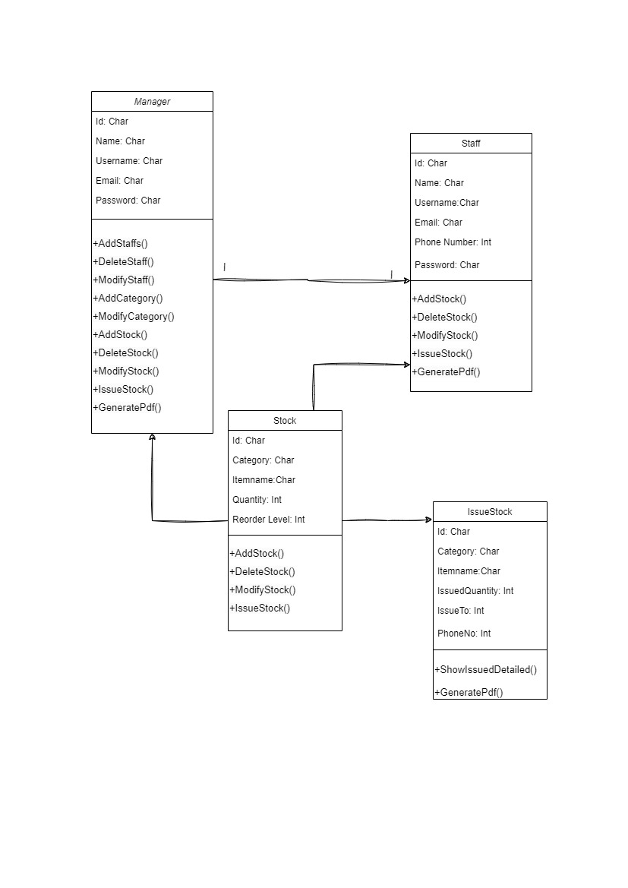
Database (Class Diagram)

Slide 10
Challenges Faced During Development
Ensuring accurate and consistent data across different modules and database tables.
Handling data validation and ensuring data integrity during various operations.
Integrating the inventory system with Django libraries and third-party APIs.
Creating a user-friendly interface that is intuitive and easy to navigate.
Balancing the need for a visually appealing design with functional requirements.
Implementing secure user authentication and authorization mechanisms.

Slide 11
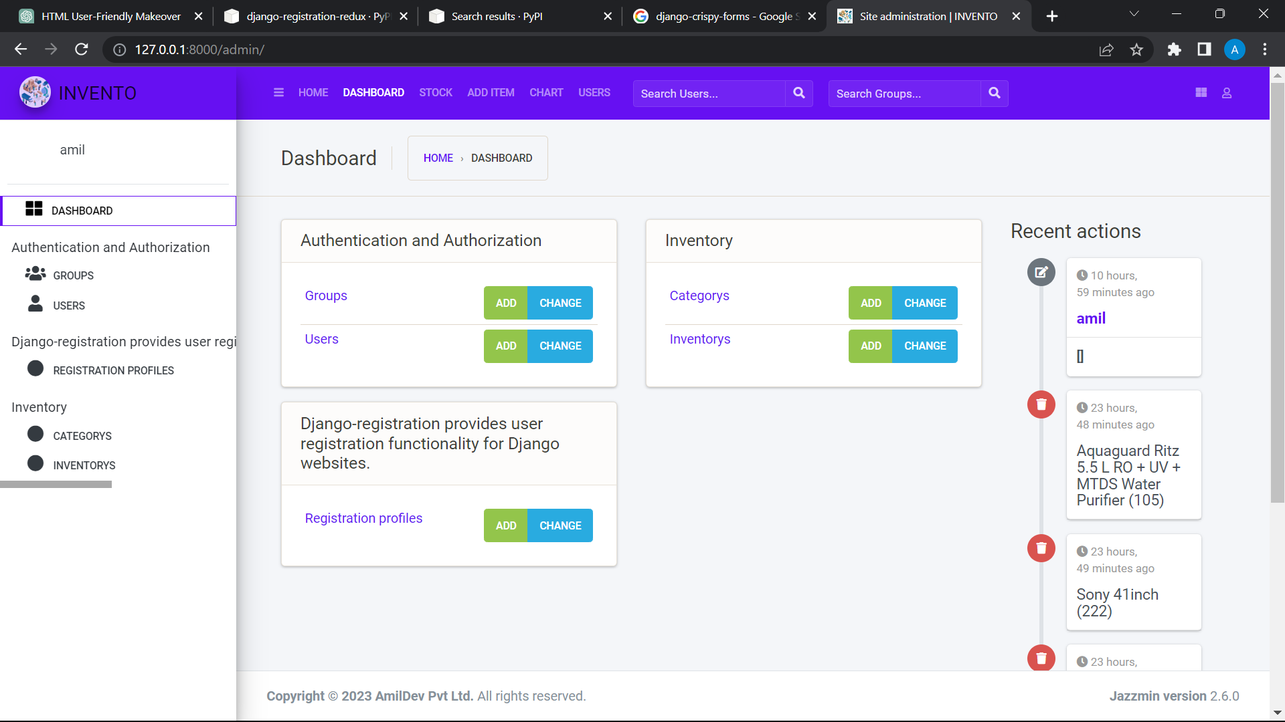
Important Screenshots
Admin Panel
Customised Django admin panel with Django-jazzmin library, which helps to make the user interface more interactive. It provides more facilities such as sidebar, logo, logo image, filter, show recent actions and so on.

Slide 12
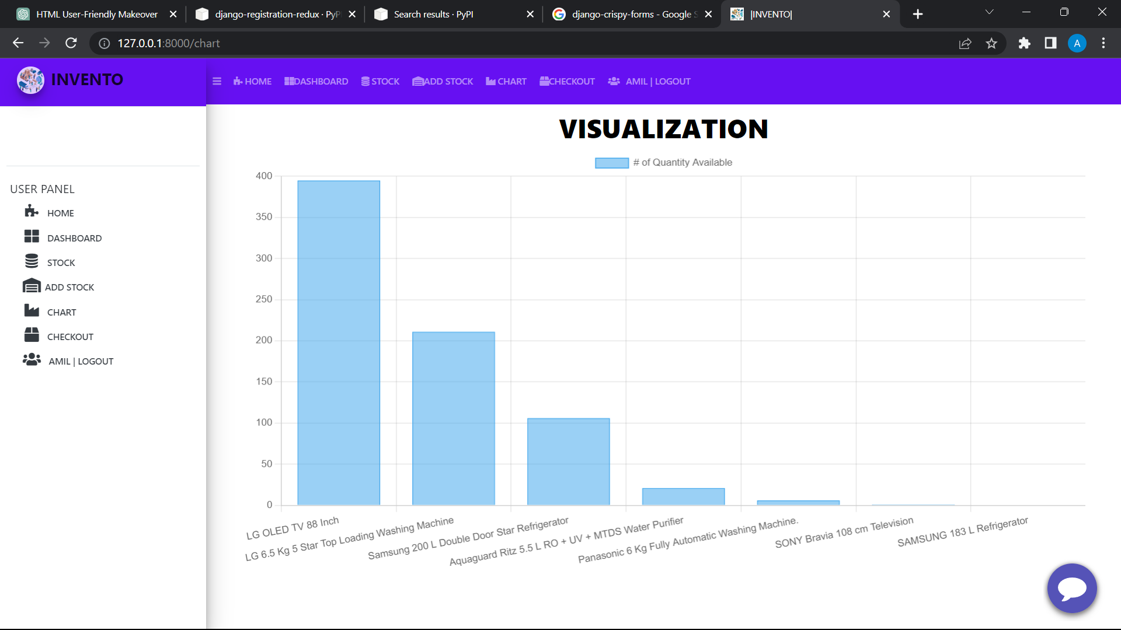
Important Screenshots
Visualization
This page provides the graphical visualization of the stock according to their quantity. Here I used Chartjs library to build the visualization and the chart used is Bar Graph.

Slide 13
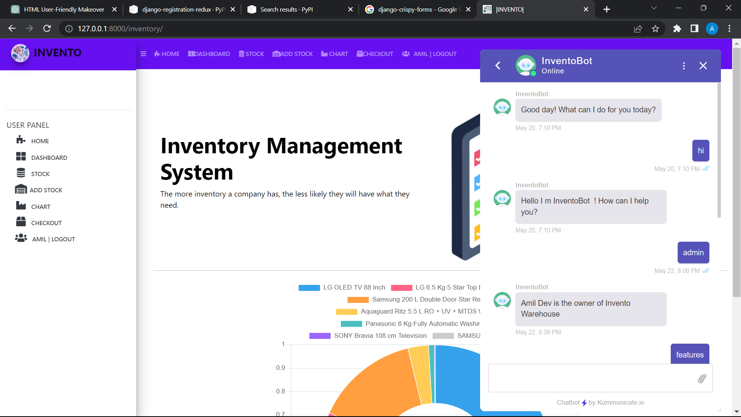
Important Screenshots
Mini ChatBot
Mini Chatbot is one of the interesting feature in the Online Inventory Management System. The main purpose of the chatbot is to provide guide for the newly joined staff to know the features and procedures of the website. Dialogflow ,owned by Google is used to build the chatbot with the help of Kommunicate.io

Slide 14
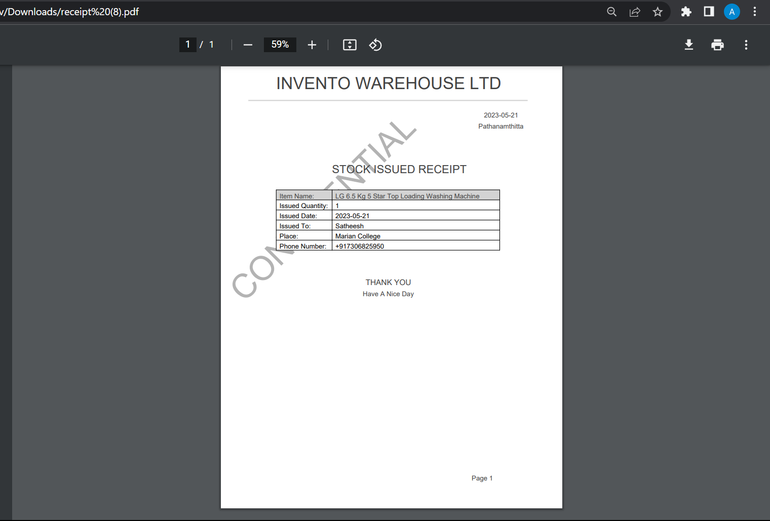
Important Screenshots
Stock Issue Receipt
When the stock is issued by the staff, the system will automatically provide a stock issued receipt, which is in the form of PDF. It includes the selected product, quantity, issued date, customer name and details .

Slide 15
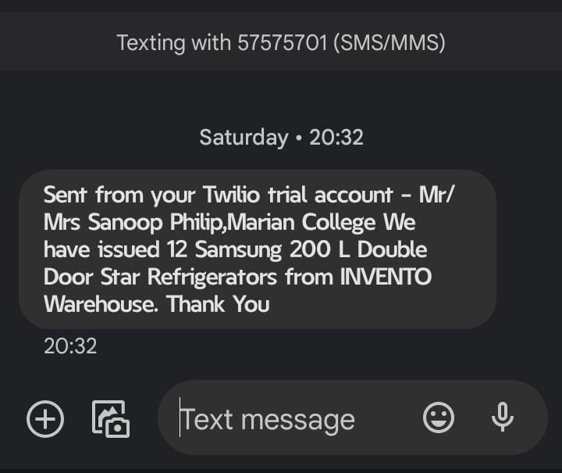
Important Screenshots
Stock Issued SMS
If the stock issued successfully, an sms notification will send to the customer’s phone number. It includes the customer details and the name of issued product with the number of quantity issued. SMS Notification is integrated with the help of Twilio, which is a third party API to provide notifications and calls etc.

Slide 16
Future Enhancement
Develop a mobile application to provide on-the-go access to the inventory system.
Enable barcode scanning using mobile device cameras for quick product identification.
Enhance reporting capabilities to provide more detailed insights into inventory levels, sales trends, and profitability.
Extend the system to include warehouse management features such as location tracking, bin management, and stock transfers between warehouses.
Predict future stock requirements based on historical data and market trends.

Slide 17
Conclusion
In conclusion, the development of an Online Inventory Management System offers significant benefits to businesses in effectively managing their inventory, streamlining operations, and improving overall efficiency .
By implementing features such as real-time inventory tracking, the system provides accurate and up-to-date inventory information. The user-friendly interface ensures easy navigation and efficient management of stock . The project has leveraged the power of Django, a robust web framework, along with third-party libraries to achieve a scalable and secure solutions . It contributes to improved productivity and cost savings.
By continually evolving and incorporating future enhancements, the system can adapt to the changing business landscape and ensure sustained growth and success.

Slide 18

References
https://youtu.be/iINE3iaN1Oo
https://developer.mozilla.org/en-US/docs/Learn/Server-side/Django
https://djangopackages.org/
https://pypi.org/
https://chat.openai.com/
https://dialogflow.cloud.google.com/
https://www.twilio.com/en-us
https://bard.google.com/

Slide 19
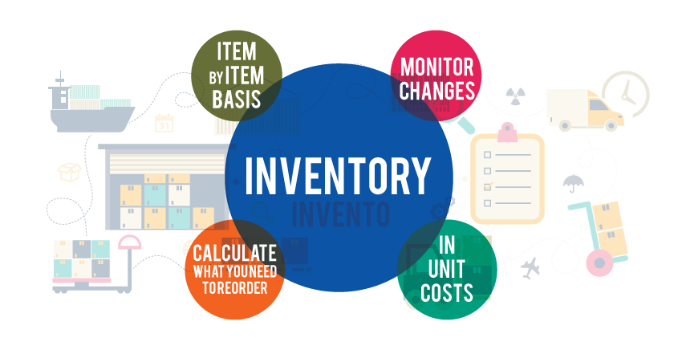



Thank you
AMIL DEV S
amildev8547@gmail.com
https://github.com/amildev8547/Inventory-Management-System

